Slide 1
Data Visualization
for Evaluators
Communicating Evaluation Data Effectively
Emma Perk
Lyssa Wilson
MAE 2016

Slide 2
Who Are We?
Emma Perk
  Data viz nerd, mother, Antarctic hiker,
  and organizational guru
Lyssa Wilson
  Visual learner, evaluator, sleep-deprived
  doc student, and over-thinker

Slide 3

Who Are You?
Meet Your Neighbor!
Your name
The most unique place you’ve traveled to
Experience with or interest in Data Visualization

Slide 4
Agenda
Part I
  Evaluation questions
  Group Activity
Part II
  Matching charts to evaluation questions
  Group Activity
Part III
  Case Study

Slide 5
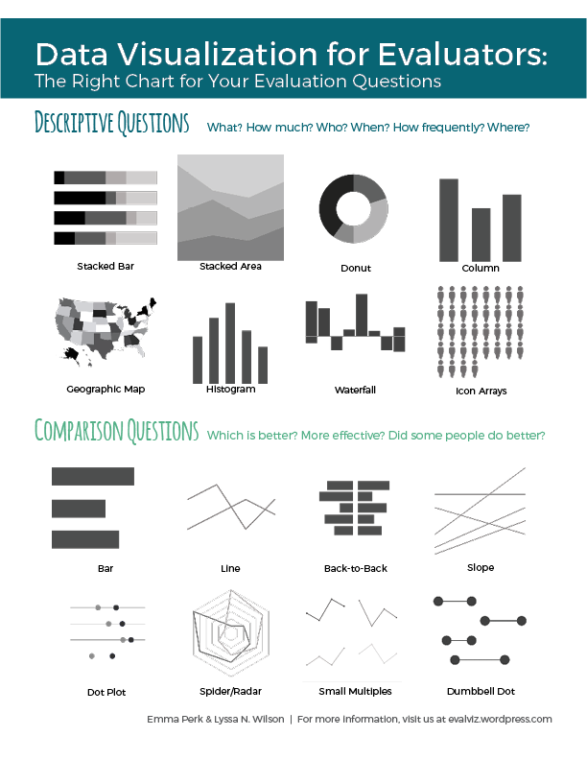
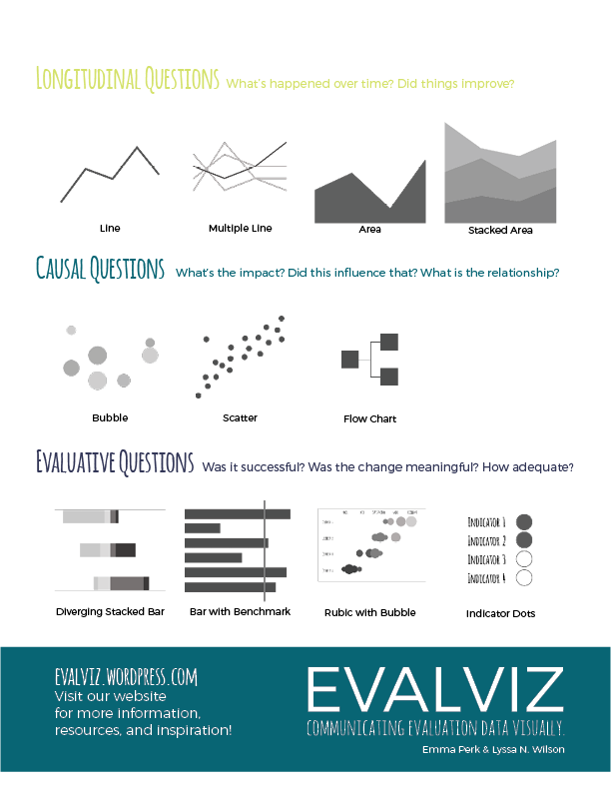
Handout

Slide 6
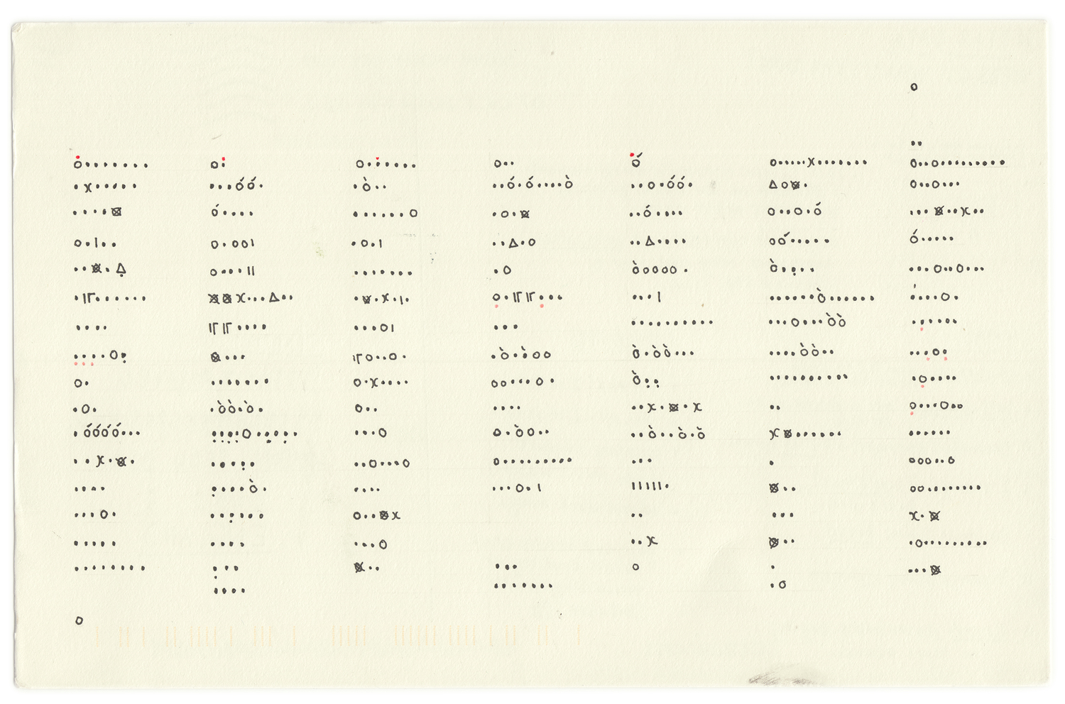

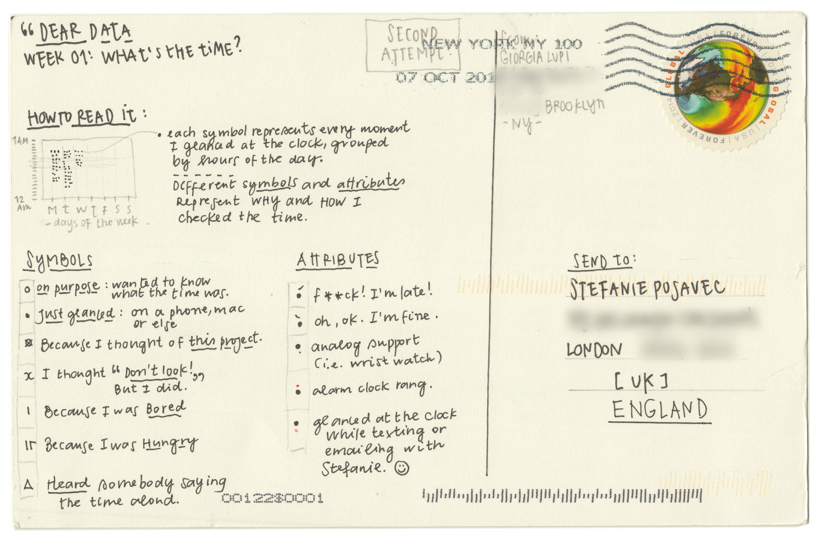
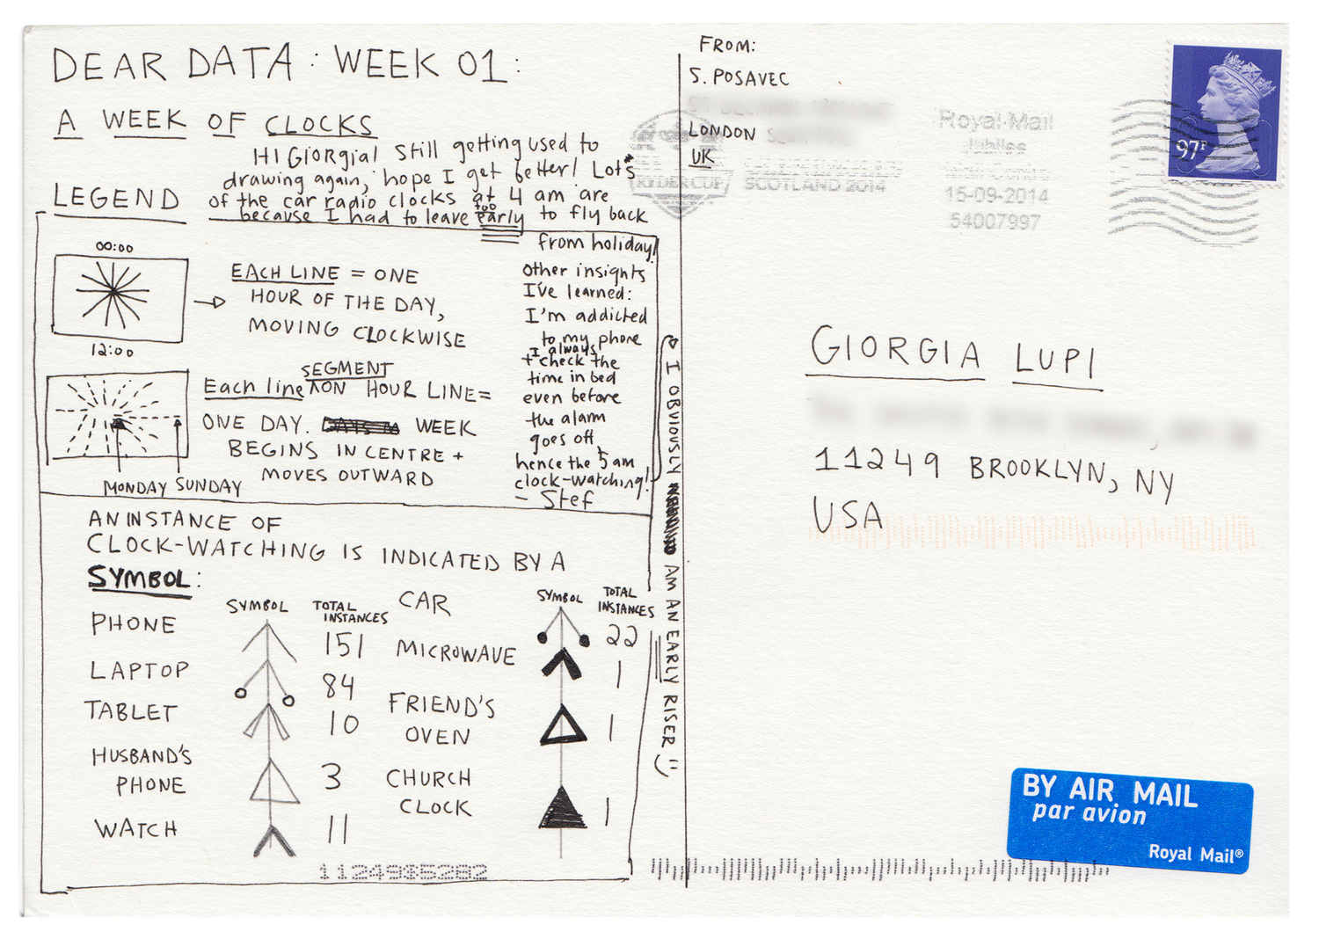
What is Data Visualization?
  (Dear Data, Week of Clocks)

Slide 7
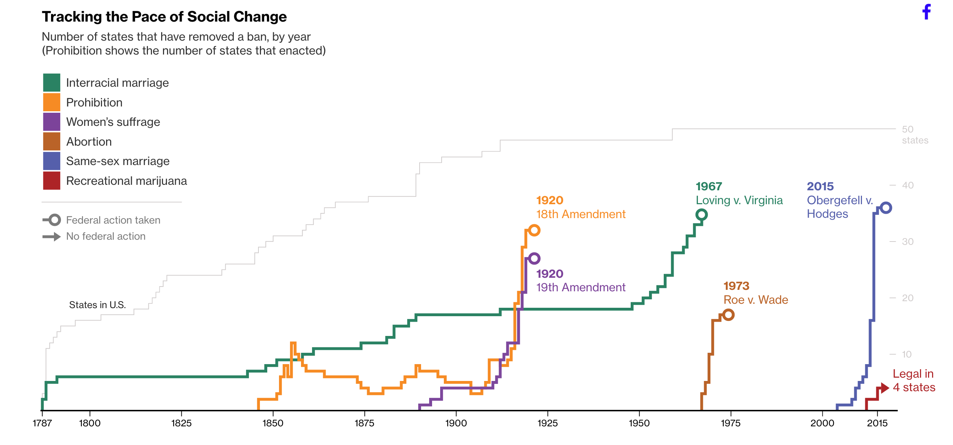
Data Visualization
This Is How Fast America
Changes Its Mind
  (Tribou & Collins, Bloomberg, 2015)

Slide 8
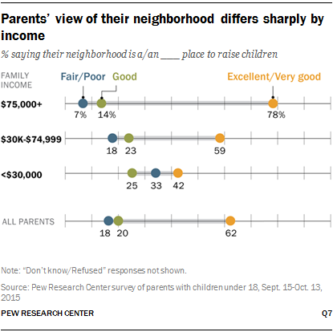
Data Visualization
  (Pew Research Center, 2015)

Slide 9

Why Visualize?

Slide 10
Part I
Evaluation Questions

Slide 11




From Evaluation Questions to Data Visualization
?
Purpose
Methods
Use
Evaluation Questions
Reporting

Slide 12





Evaluation Questions
Why important?
Define Boundaries
Frame Scope
Structure Planning
Foundation of Solid Evaluation
Inform Use
  (Wingate & Schroeter, 2015; Rossi, Lipsey & Freeman, 2004, p. 54; Robinson, 2014; Russ-Eft, p. 355)

Slide 13
Evaluation Questions
What makes a good EQ?
✓
Evaluative
✓
Specific
✓
Pertinent
✓
Answerable
✓
Reasonable
✓
Complete
  (Wingate & Schroeter, 2015; USAID, n.d.,; CDC, 2013)

Slide 14

Resources for good EQ’s
https://www.wmich.edu/evaluation/checklists

Slide 15

Resources for good EQ’s
http://www.cdc.gov/asthma/program_eval/AssessingEvaluationQuestionChecklist.pdf

Slide 16
Evaluation Questions
Types of EQs
Descriptive
Comparison
Longitudinal
Causal
Evaluative

Slide 17
Evaluation
Questions
Descriptive
Questions presenting descriptive data
about the program or surrounding context.
Asks Questions like What? How much? Who? When? How frequently? Where?
Evaluative Examples:
  What does the program look like?
  Who has this program been serving?
  How many of the target population did the program reach?
  Where has the program been delivered?
  To what extent was this program implemented as designed?

Slide 18
Evaluation
Questions
Comparison
Questions that compare two or
more groups, aspects, or outcomes.
Asks Questions like Which is better? more effective? Did some do better?
Evaluative Examples:
  Is this program more effective than others?
  Do some people do better in this program than others?
  How did this program perform compared to other similar programs?

Slide 19
Evaluation
Questions
Longitudinal
Questions that ask about
trends over time.
Asks Questions like What’s happened over time? Did things improve?
Evaluative Examples:
  Has this program decreased X over time?
  Has this program increased their delivery over the past 5 years?

Slide 20
Evaluation
Questions
Causal
Questions addressing the
outcome or impact of a program.
Asks Questions like Which is better? more effective? Did some do better?
Evaluative Examples:
  Was the program the cause of …
  What is the relationship between x and y?

Slide 21
Evaluation
Questions
Evaluative
Questions specifically meant
to report evaluative information.
Asks Questions like Was it successful? Was the change meaningful? How adequate?
Evaluative Examples:
  Was this program good?
  How adequate was the reach? Did they reach the right population?
  How important were the outcomes?
  How substantial was the change observed?

Slide 22
Group Activity 1
Evaluation Questions
Decide on a program
Identify 3 evaluation questions
Categorize what type of questions are they asking
  Descriptive
  Comparison
  Longitudinal
  Causal
  Evaluative

Slide 23
Part II
Data Viz & Charts

Slide 24
Data Viz Guidelines
What makes a good Data Viz?
✓
Purposeful
✓
Strategic in design
✓
Clear
✓
Absent of clutter
✓
easy
✓
Tells a Story

Slide 25





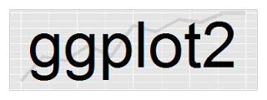
Software
(Olson, 2016)

Slide 26




Chart Resources

Slide 27
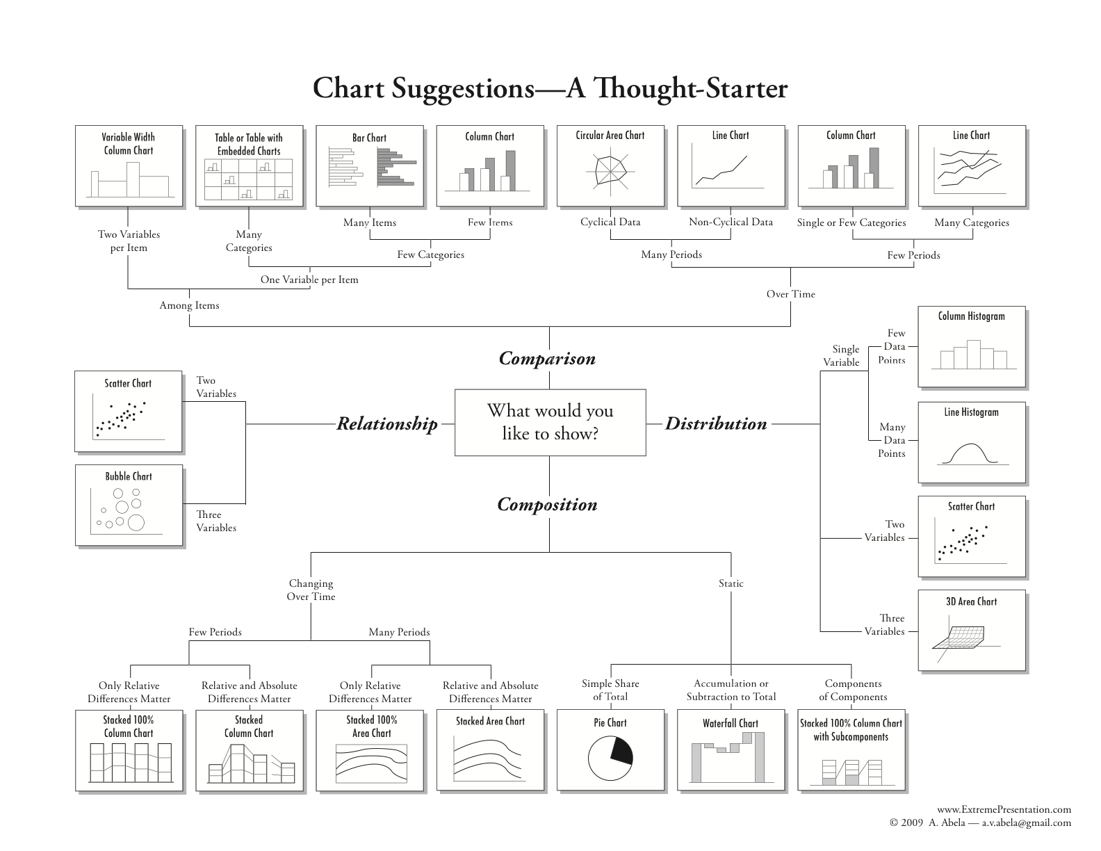
Charts Based on Data Type
(Abela, 2009)

Slide 28
Evaluation Questions
Types of EQs
Descriptive - composition & distribution
Comparison - comparison among items
Longitudinal - comparison over time
Causal - relationship
Evaluative - evaluation specific

Slide 29





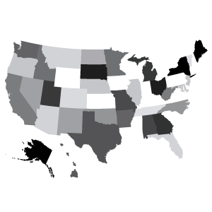


Evaluation
Questions
Descriptive
Asks Questions like What? How much? Who? When? How frequently? Where?
Stacked Bar
Stacked Area
Donut
Column
Geographic Map
Histogram
Waterfall
Icon Arrays

Slide 30






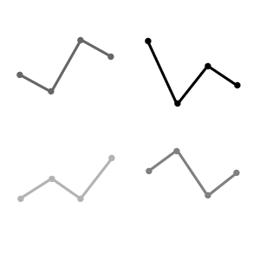

Evaluation
Questions
Comparison
Asks Questions like Which is better? more effective? Did some do better?
Bar
Line
Back to Back
Slope
Dot Plot
Spider/Radar
Small Multiples
Dumbbell Dot

Slide 31




Evaluation
Questions
Longitudinal
Asks Questions like What’s happened over time? Did things improve?
Line
Multiple Line
Area
Stacked Area

Slide 32



Evaluation
Questions
Causal
Asks Questions like What’s the impact? Did this influence? What is the relationship?
Bubble
Scatter
Flow Chart

Slide 33

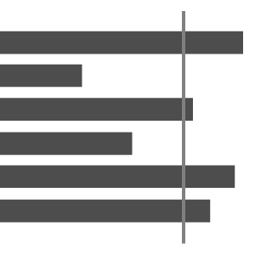
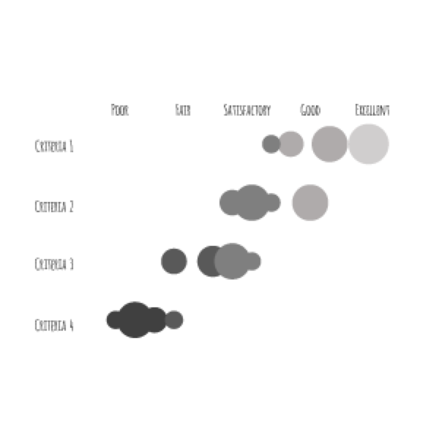
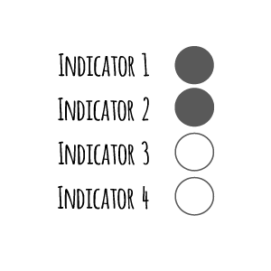
Evaluation
Questions
Evaluative
Asks Questions like Was it successful? Was the change meaningful? How adequate?
Diverging Stacked Bar
Bar with Benchmark
Rubric with Bubble
Indicator Dots

Slide 34
Group Activity 2
Evaluation Questions
Decide on a program
Identify 3 evaluation questions
Categorize what type of questions are they asking
  Descriptive
  Comparison
  Longitudinal
  Causal
  Evaluative

Slide 35
Part III
Case Study

Slide 36

Case Study
Reconnect
Notes:
Reconnect is a community initiative to prevent recurrent homelessness in people with severe mental illness. This critical time intervention partners individuals discharged from a shelter, hospital, or other institution with caseworkers in an intensive six-month program. Goals include rapid re-housing, credit building, job skill training, and other employment resources.

Slide 37
Descriptive
Geographic Map
EQ:
In which neighborhoods are Reconnect participants living after completing the program?

Slide 38
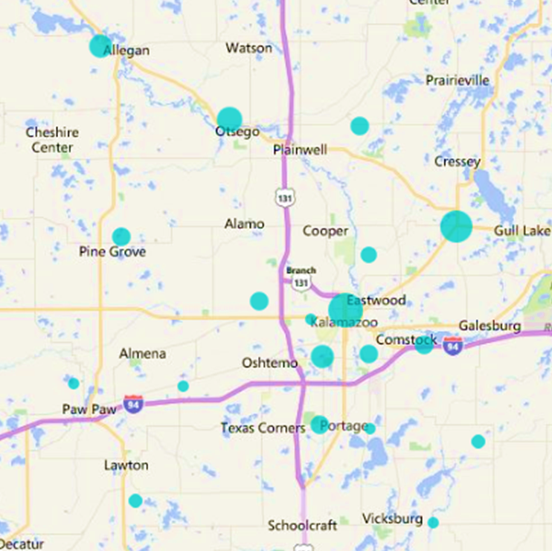
Descriptive
Geographic Map
Most Reconnect participants are living in downtown Kalamazoo or Gull Lake.
  Created in excel using Bing Maps plugin

Slide 39
Comparison
Slope Chart
EQ:
Does Reconnect serve a different population than its companion site when considering race and ethnicity?

Slide 40
Comparison
Slope Chart
Reconnect serves more black and white participants than its comparison site, but less Hispanic participants.

Slide 41
Longitudinal
Dumbbell Dot Chart
EQ:
Did clients increase their understanding of the renting process after participating in Reconnect programming?

Slide 42
Longitudinal
Dumbbell Dot Chart
Detroit
Grand Rapids
Kalamazoo
Lansing

Slide 43
Evaluative
Divergent Stacked Bar Chart
EQ:
Did Reconnect meet its success goals in having over 50% of participants strongly agree or agree on Indicators 1, 2, and 3?

Slide 44
Evaluative
Divergent Stacked Bar Chart
Strongly Agree
Agree
Disagree
Strongly Disagree
Indicator 1
Indicator 2
Indicator 3

Slide 45
Evaluative
Cartesian Coordinates
EQ:
Which of the three potential new projects should Reconnect pursue given their potential for impact and their ease of implementation?

Slide 46
Evaluative
Cartesian Coordinates
Low Impact
High Impact
Easy Implementation
P3
P1
P1
Project 1 has the highest possible impact and easy implementation.
Hard Implementation
P2

Slide 47
Evaluative
Rubric with Bubbles
EQ:
How adequately is Reconnect performing on each of their four success criteria?

Slide 48
Evaluative
Rubric with Bubbles
Reconnect is performing well on Criteria 3 and Criteria 2, but not well on
Criteria 1 or Criteria 4.
  Are of bubble corresponds to a ranking of data quality.

Slide 49
Questions?

Slide 50
Thank You!!

Slide 51
EVALVIZ
Communicating Evaluation Data Visually.
www.evalviz.wordpress.com

